Slide 1

Data Integration and Large Scale Analysis 05 Entity Linking and Deduplication
Slides Credit: Matthias Boehm
Last update: Nov 15, 2024

Slide 2
Agenda
Motivation and Terminology
Entity Resolution Concepts
Entity Resolution Tools
Example Applications

Slide 3
Motivation and Terminology

Slide 4
Recap: Corrupted/Inconsistent Data
Motivation and Terminology
#1 Heterogeneity of Data Sources
Update anomalies on denormalized data / eventual consistency
Changes of app/prep over time (US vs us) → inconsistencies
#2 Human Error
Errors in semi-manual data collection, laziness (see default values), bias
Errors in data labeling (especially if large-scale: crowd workers / users)
#3 Measurement/Processing Errors
Unreliable HW/SW and measurement equipment (e.g., batteries)
Harsh environments (temperature, movement) → aging
No Global Keys
Uniqueness & duplicates
Contradictions & wrong values
Missing Values
[Credit: Felix Naumann]
Ref. Integrity
ID | Name | BDay | Age | Sex | Phone | Zip
3 | Smith, Jane | 05/06/1975 | 44 | F | 999-9999 | 98120
3 | John Smith | 38/12/1963 | 55 | M | 867-4511 | 11111
7 | Jane Smith | 05/06/1975 | 24 | F | 567-3211 | 98120
Zip | City
98120 | San Jose
90001 | Lost Angeles
Typos

Slide 5
Terminology
Motivation and Terminology
[Douglas Burdick, Ronald Fagin, Phokion G. Kolaitis, Lucian Popa, Wang-Chiew Tan: Expressive power of entity-linking frameworks. J. Comput. Syst. Sci. 2019]
Entity Linking
“Entity linking is the problem of creating links among records representing real-world entities that are related in certain ways.”
“As an important special case, it includes entity resolution, which is the problem of identifying or linking duplicate entities
Other Terminology
Entity Linking → Entity Linkage, Record Linkage
Entity Resolution → Data Deduplication, Entity Matching
Applications
Named entity recognition and disambiguation
Archiving, knowledge bases and graphs
Recommenders / social networks
Financial institutions (persons and legal entities)
Travel agencies, transportation, health care
☺
Barack Obama
Barack Hussein Obama II
The US president (2016)
Barack and Michelle are married ….

Slide 6
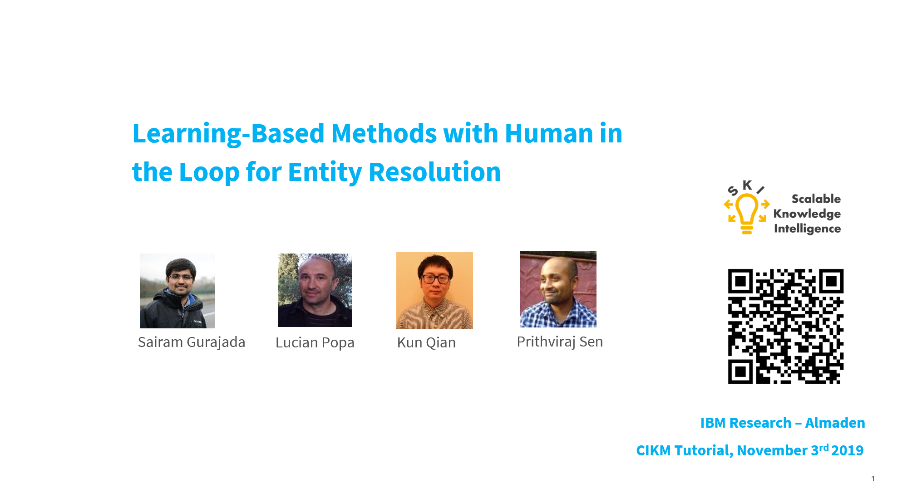
Entity Resolution Concepts
[Xin Luna Dong, Theodoros Rekatsinas: Data Integration and Machine Learning: A Natural Synergy. Tutorials, SIGMOD 2018, PVLDB 2018, KDD 2019]
[Sairam Gurajada, Lucian Popa, Kun Qian, Prithviraj Sen: Learning-Based Methods with Human in the Loop for Entity Resolution, Tutorial, CIKM 2019]
[Felix Naumann, Ahmad Samiei, John Koumarelas: Master project seminar for Distributed Duplicate Detection. Seminar, HPI WS 2016]

Slide 7
Problem Formulation
Entity Resolution Concepts
Entity Resolution
“Recognizing those records in two files which represent identical persons, objects, or events”
Given two data sets A and B
Decide for all pairs of records a_{i} – b_{j} in A x B if match (link), no match (non-link), or not enough evidence (possible-link)
Naïve Deduplication
UNION DISTINCT via hash group-by or sort group-by
Problem: only exact matches
➔ Similarity Measures
Token-based: e.g., Jaccard J(A,B) = (A ∩ B) / (A ∪ B)
Edit-based: e.g., Levenshtein lev(A,B) → min(replace, insert, delete)
Phonetic similarity (e.g., soundex, metaphone), Python lib Jellyfish
[Ivan Fellegi, Alan Sunter: A Theory for Record Linkage, J. American. Statistical Assoc., pp. 1183-1210, 1969]
Name | Position | Affiliation | Department
Shafaq Siddiqui | Lecturer | Sukkur IBA | CS
Shafaq Siddiqi | TA | TU Graz | CSBME

Slide 8

Entity Resolution Pipeline
Entity Resolution Concepts
Prepare Data
Blocking/Sorting
Matching
Clustering
A2
A2
A
r1, r4
A1
C1
D1
A1
A1
A2
B1
B2
C2
C1
C2
C
r2, r7
C1
C2
B3
D1
D1
D
r3
B1
B2
B1
B2
r5, r6, r8
B3
B3
B

Slide 9
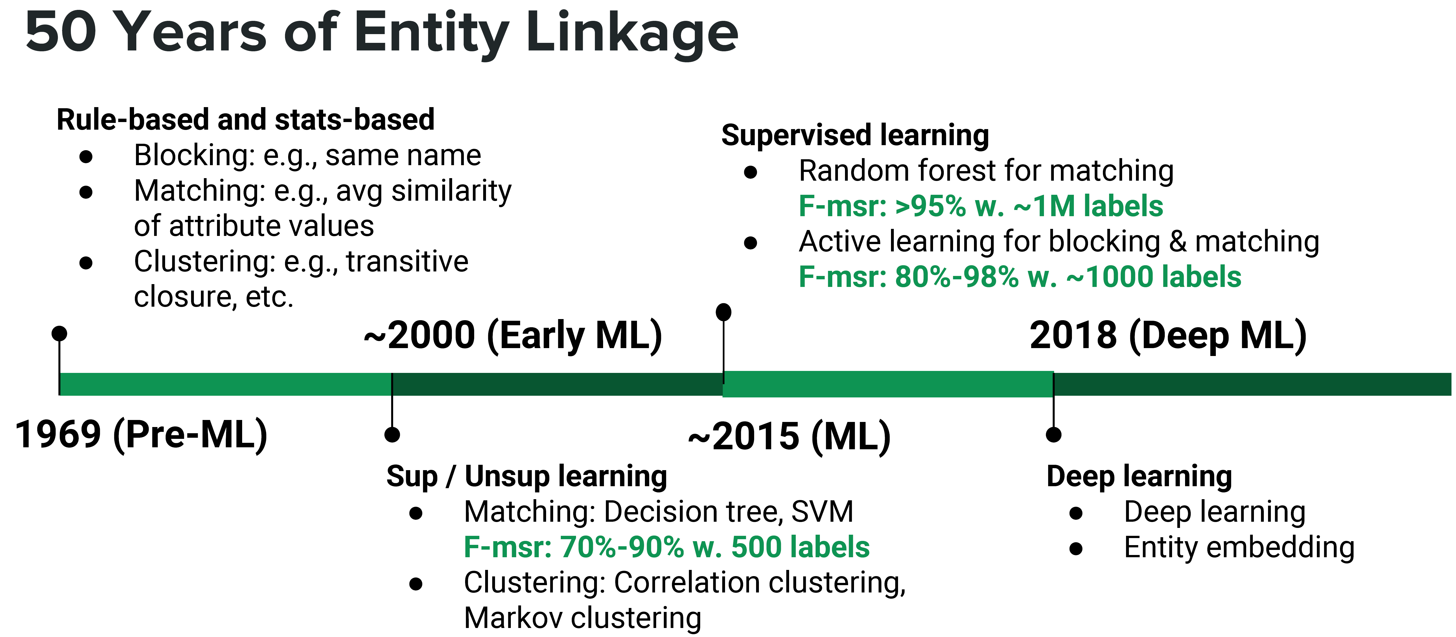
Entity Linking Approaches
Entity Resolution Concepts
[Xin Luna Dong, Theodoros Rekatsinas: Data Integration and Machine Learning: A Natural Synergy. PVLDB 2018]

Slide 10
Step 1: Data Preparation
Entity Resolution Concepts
#1 Schema Matching and Mapping
See lecture 04 Schema Matching and Mapping
Create homogeneous schema for comparison
Split composite attributes
#2 Normalization
Removal of special characters and white spaces
Stemming
Capitalization (to upper/lower)
Remove redundant works, resolve abbreviations
#3 Data Cleaning
See lecture 06 Data Cleaning and Data Fusion
Correct data corruption and inconsistencies
Autonomous, heterogeneous systems
likes/liked/likely/liking → like

Slide 11
Step 2: Blocking and Sorting
Entity Resolution Concepts
#1 Naïve All-Pairs
Brute-force, naïve approach → n*(n-1)/2 pairs → O(n²) complexity
#2 Blocking / Partitioning
Efficiently create small blocks of similar records for pair-wise matching
Basic: equivalent values on selected attributes (name)
Predicates: whole field, token field, common integer, same x char start, n-grams
Hybrid: disjunctions/conjunctions
Blocking Keys:
Learned: Minimal rule set via greedy algorithms
➔ Significant reduction: 1M records → 1T pairs ➔ 1K partitions w/ 1K records → 1G pairs (1000x)
→ JR01111
John Roberts | 20 Main St | Plainville | MA | 01111
Julia Ray | 32 Main St | Plainville | MA | 01111
[Nicholas Chammas, Eddie Pantrige: Building a Scalable Record Linkage System, Spark+AI Summit 2018]

Slide 12
Step 2: Blocking, cont.
Entity Resolution Concepts
#3 Sorted Neighborhood
Define sorting keys (similar to blocking keys)
Sort records by sorting keys
Define sliding window of size m (e.g., 100) and compute all-pair matching within sliding window
#4 Blocking via Word Embeddings and LSH/DL
Compute word/attribute embeddings + tuple embeddings
Locality-Sensitive Hashing (LSH) for blocking
K hash functions h(t) → k-dim hash-code
L hash tables, each k hash functions
Distributed Tuple Representation
[Muhammad Ebraheem et al: Distributed Representations of Tuples for Entity Resolution. PVLDB 2018]
[Saravanan Thirumuruganathan et al. Deep Learning for Blocking in Entity Matching […]. PVLDB 2021]
h1=[-1, 1,1], h2=[ 1,1, 1], h3=[-1,-1,1], h4=[-1,1,-1],
V %*% H
v[t1]=[0.45,0.8,0.85]
v[t2]=[0.4,0.85,0.75]
[1.2,2.1,-0.4,-0.5]
[1.2,2.0,-0.5,-0.3]
[1,1,-1,-1]
[1,1,-1,-1]
[12]
[12]
Hash bucket
Notes:
V = matrix(c(0.45,0.8,0.85,0.4,0.85,0.75),2,3,byrow=TRUE)
H = matrix(c(-1,1,1,1,1,1,-1,-1,1,-1,1,-1), 3, 4)
V %*% H

Slide 13
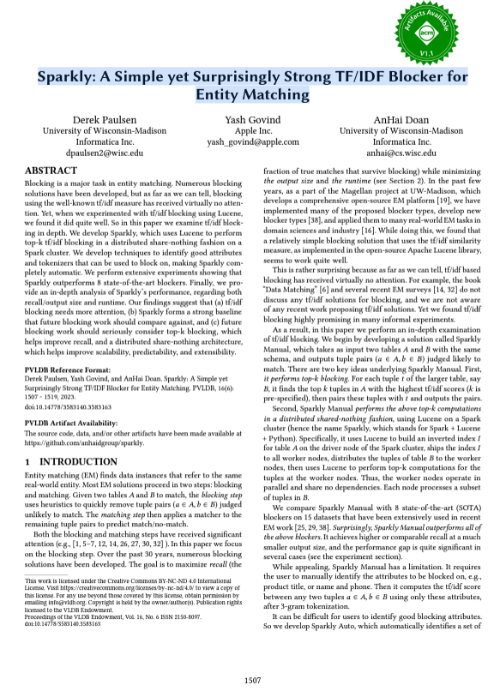
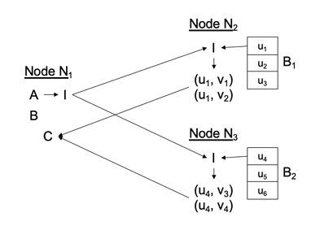
Step 2: Blocking, cont.
Entity Resolution Concepts
[Derek Paulsen et al: Sparkly: A Simple yet Surprisingly Strong TF/IDF Blocker for Entity Matching. PVLDB 2023]
#5 TF/IDF based blocking
Build inverted index of smaller table A
Ship index and tuples of larger table B to other nodes in the cluster
Find top-k matches in table A for the tuples of table B
Notes:
Probes index I to find topk tuples in tableA with the highest tf/idf scores

Slide 14
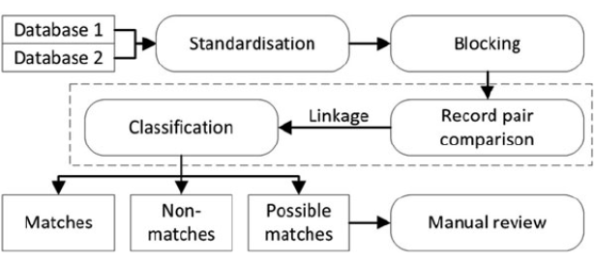
Step 3: Matching
Entity Resolution Concepts
#1 Basic Similarity Measures
Pick similarity measure sim(r, r’) and thresholds: high θ_{h} (and low θ_{l})
Record similarity: avg attribute similarity
Match: sim(r, r’) > θ_{h} Non-match: sim(r, r’) < θ_{l} possible match: θ_{l} < sim(r, r’) < θ_{h}
#2 Learned Matchers (Traditional ML)
Phase 1: Model Generation
Phase 2: Model Application
Selection of samples for labeling (sufficient, suitable, balanced)
SVM and decision trees, logistic regression, random forest, XGBoost
[O’Hare, K.et.al. D. P., & A. Jurek-Loughrey,2019]
[Mikhail Bilenko, Raymond J. Mooney: Adaptive duplicate detection using learnable string similarity measures. KDD 2003]
[Hanna Köpcke, Andreas Thor, Erhard Rahm: Evaluation of entity resolution approaches on real-world match problems. PVLDB 2010]
[Xin Luna Dong: Building a Broad Knowledge Graph for Products. ICDE 2019]

Slide 15
Step 3: Matching, cont.
Entity Resolution Concepts
Deep Learning for ER
Automatic representation learning from text (avoid feature engineering)
Leverage pre-trained word embeddings for semantics (no syntactic limitations)
Example DeepER
Example Magellan
DL for text and dirty data
[Muhammad Ebraheem et al: Distributed Representations of Tuples for Entity Resolution. PVLDB 2018]
Abs Difference / Hadamard Prod.
[Sidharth Mudgal et al: Deep Learning for Entity Matching: A Design Space Exploration. SIGMOD 2018]
Distributed Tuple Representation

Slide 16
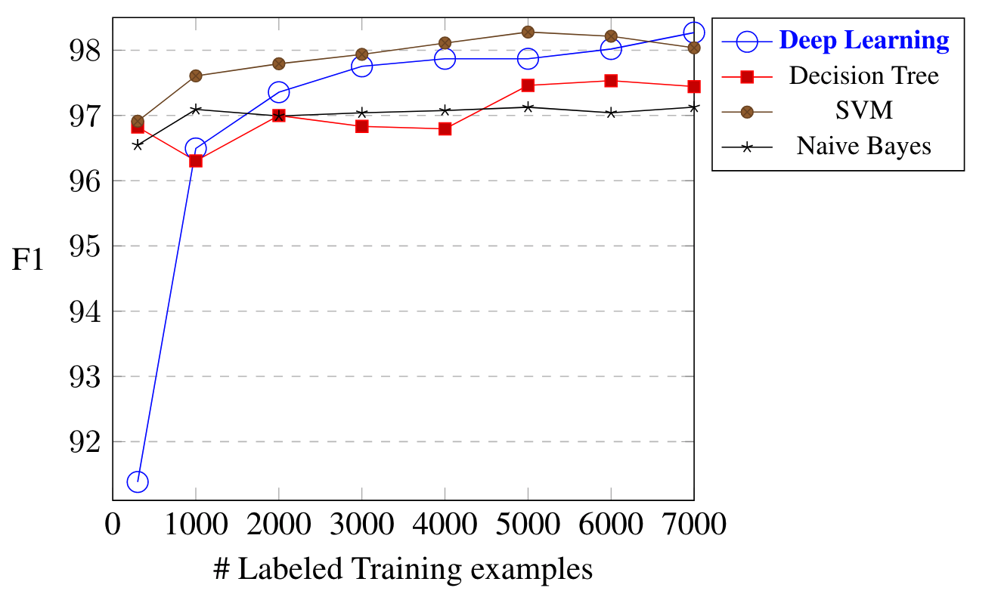

Step 3: Matching, cont.
Entity Resolution Concepts
[Sairam Gurajada, Lucian Popa, Kun Qian, Prithviraj Sen: Learning-Based Methods with Human in the Loop for Entity Resolution, Tutorial, CIKM 2019]
Labeled Data
Scarce (experts)
Class skew
➔ Transfer Learning
Learn model from high-resource ER scenario (w/ regularization)
Fine-tune using low-resource examples
➔ Active Learning
Select instances for tuning to min labeling
DBLP-ACM
$$F_{1}=2⋅ \frac{precision⋅recall}{precision+recall}$$
[Jungo Kasai et al: Low-resource Deep Entity Resolution with Transfer and Active Learning. ACL 2019]

Slide 17
Step 4: Clustering
Entity Resolution Concepts
Recap: Connected Components
Determine connected components of a graph (subgraphs of connected nodes)
Propagate max(current, msgs) if != current to neighbors, terminate if no msgs
Clustering Approaches
Basic: connected components (transitive closure) w/ edges sim > θ_{h} → Issues: big clusters and dissimilar records
Correlation clustering: +/- cuts based on sims → global opt NP-hard
Markov clustering: stochastic flow simulation via random walks
Step 0
Step 1
Step 2
Step 3 converged
1
4
4
2
3
4
3
4
4
4
5
4
7
4
7
7
6
7
7
7
7
[Oktie Hassanzadeh, Fei Chiang, Renée J. Miller, Hyun Chul Lee: Framework for Evaluating Clustering Algorithms in Duplicate Detection. PVLDB 2009]

Slide 18
Incremental Data Deduplication
Entity Resolution Concepts
Goals
Incremental stream of updates → previously computed results obsolete
Same or similar results AND significantly faster than batch computation
Approach
End-to-end incremental record linkage for new and changing records
Incremental maintenance of similarity graph and incremental graph clustering
Initial graph created by correlation clustering
Greedy update approach in polynomial time
Directly connect components from increment ΔG into Q
Merge of pairs of clusters to obtain better result?
Split of cluster into two to obtain better result?
Move nodes between two clusters to obtain better result?
[Anja Gruenheid, Xin Luna Dong, Divesh Srivastava: Incremental Record Linkage. PVLDB 2014]

Slide 19
Entity Resolution Tools

Slide 20
Python Dedupe
Entity Resolution Tools
https://docs.dedupe.io/en/latest/API-documentation.html
https://dedupeio.github.io/dedupe-examples/docs/csv_example.html
Overview
Python library for data deduplication (entity resolution)
By default: logistic regression matching (and blocking)
Example
fields = [
{'field':'Site name', 'type':'String'},
{'field':'Address', 'type':'String'}]
deduper = dedupe.Dedupe(fields)
# sample data and active learning
deduper.sample(data, 15000)
dedupe.consoleLabel(deduper)
Do these records refer to the same thing?
(y)es / (n)o / (u)nsure / (f)inished
# learn blocking rules and pairwise classifier
deduper.train()
# Obtain clusters as lists of (RIDs and confidence)
threshold = deduper.threshold(data, recall_weight=1)
clustered_dupes = deduper.match(data, threshold)

Slide 21
Magellan (UW-Madison)
Entity Resolution Tools
[Pradap Konda et al.: Magellan: Toward Building Entity Matching Management Systems. PVLDB 2016]
System Architecture
How-to guides for users
Tools for individual steps of entire ER pipeline
Build on top of existing Python/big data stack
Scripting environment for power users
User
[Yash Govind et al: Entity Matching Meets Data Science: A Progress Report from the Magellan Project. SIGMOD 2019]

Slide 22
SystemER (IBM Research – Almaden)
Entity Resolution Tools
[Kun Qian, Lucian Popa, Prithviraj Sen: SystemER: A Human-in-the-loop System for Explainable Entity Resolution. PVLDB 2019]
Learns explainable ER rules (in HIL)
DBLP.title = ACM.title
AND DBLP.year = ACM.year
AND jaccardSim(DBLP.authors,ACM.authors)>0.1
AND jaccardSim(DBLP.venue,ACM.venue)>0.1
→ SamePaper(DBLP.id,ACM.id)
[Mauricio A. Hernández, Georgia Koutrika, Rajasekar Krishnamurthy, Lucian Popa, Ryan Wisnesky:
HIL: a high-level scripting language for entity integration. EDBT 2013]

Slide 23
BEER (Blocking for Effective Entity Resolution)
Entity Resolution Tools
[Sainyam Galhotra, Donatella Firmani, Barna Saha, and Divesh Srivastava: BEER: Blocking for Effective Entity Resolution, SIGMOD 2021]
Feedback after 1% sample

Slide 24
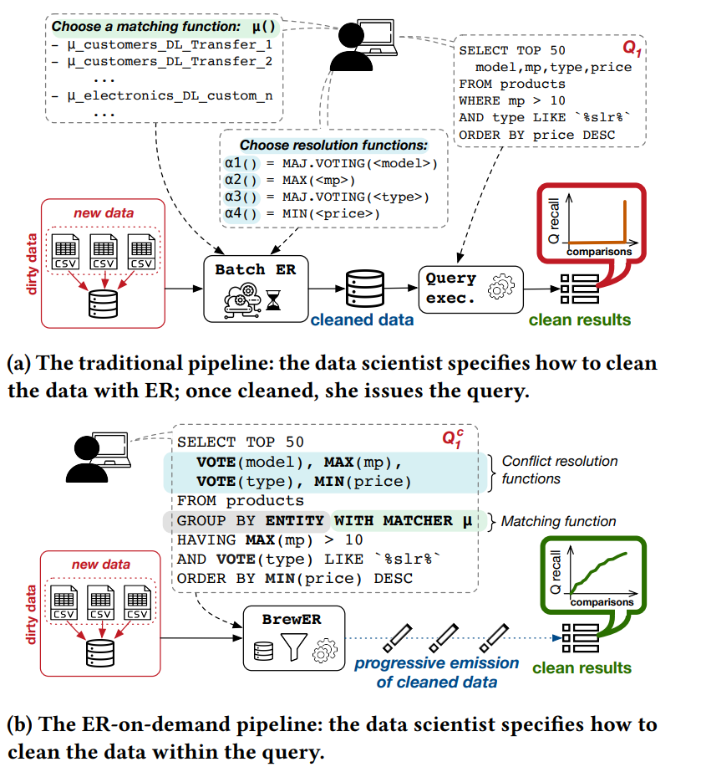
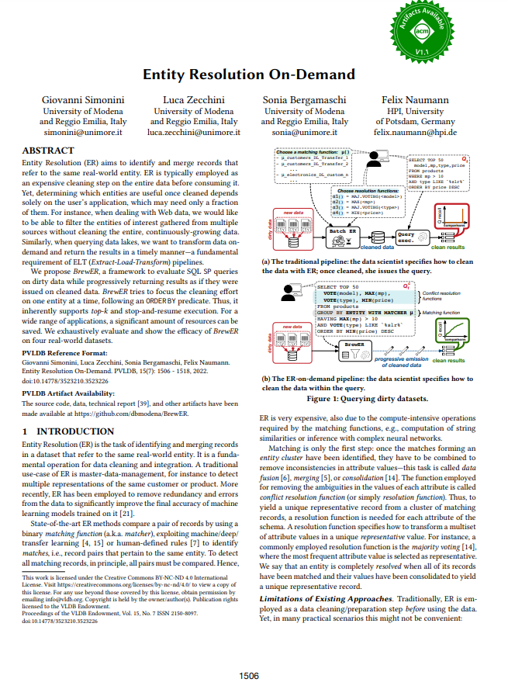
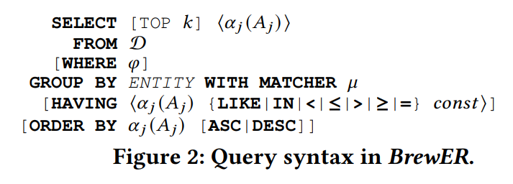
BrewER (Entity Resolution On-Demand)
Entity Resolution Tools
[Giovanni Simonini, Luca Zecchini, Sonia Bergamaschi, Felix Naumann: Entity Resolution On-Demand. PVLDB 2022]

Slide 25
Example Applications

Slide 26
Record Linkage
Example Applications
Task: Distributed Entity Resolution on Apache Spark
Uni Leipzig Benchmarks
Example 1: DBLP, ACM, Google Scholar Publications
(title, authors, venue, year)
Basic preprocessing via title capitalization, etc
How about leveraging the linked PDF papers?
Example 2: Amazon, Google Products
(name, description, manufacturer, price)
NLP for matching medium and long descriptions, e.g., word embeddings
How about leveraging the product images (different angles)
SIGMOD Programming Contest 2022
Design blocking scheme for Notebooks specifications dataset
https://dbs.uni-leipzig.de/ research/projects/object_matching/ benchmark_datasets_for_entity_resolution
In practice: multi-modal data, and feature engineering
https://dbgroup.ing.unimore.it/sigmod22contest/task.shtml?content=description

Slide 27
Data Management – Autograding
Example Applications
Plagiarism Detection via Entity Resolution
https://issues.apache.org/jira/browse/SYSTEMDS-3191
Data preparation: file names/properties, runtime, correctness
Blocking: by programming language, results sets
Matching
Exact matches via basic diff + threshold
Code similarity via SotA embeddings
Clustering
Connected components within each block (min sim threshold)
[Fangke Ye et al: MISIM: An End-to-End Neural Code Similarity System. CoRR 2020
arxiv.org/pdf/2006.05265.pdf]

Slide 28
Summary and Q&A
Motivation and Terminology
Entity Resolution Concepts
Entity Resolution Tools
Example Applications
Next Lectures (Data Integration Architectures)
06 Data Cleaning and Data Fusion [Nov 22]
Fundamental Data Integration Technique, w/ lots of applications + remaining challenges

